Slide 1

Respiratory Health Analysis

Slide 2

AGENDA
INTRODUCTION
What is the data about
How are we going to use that
Creating target and model building
Future scope

Slide 3
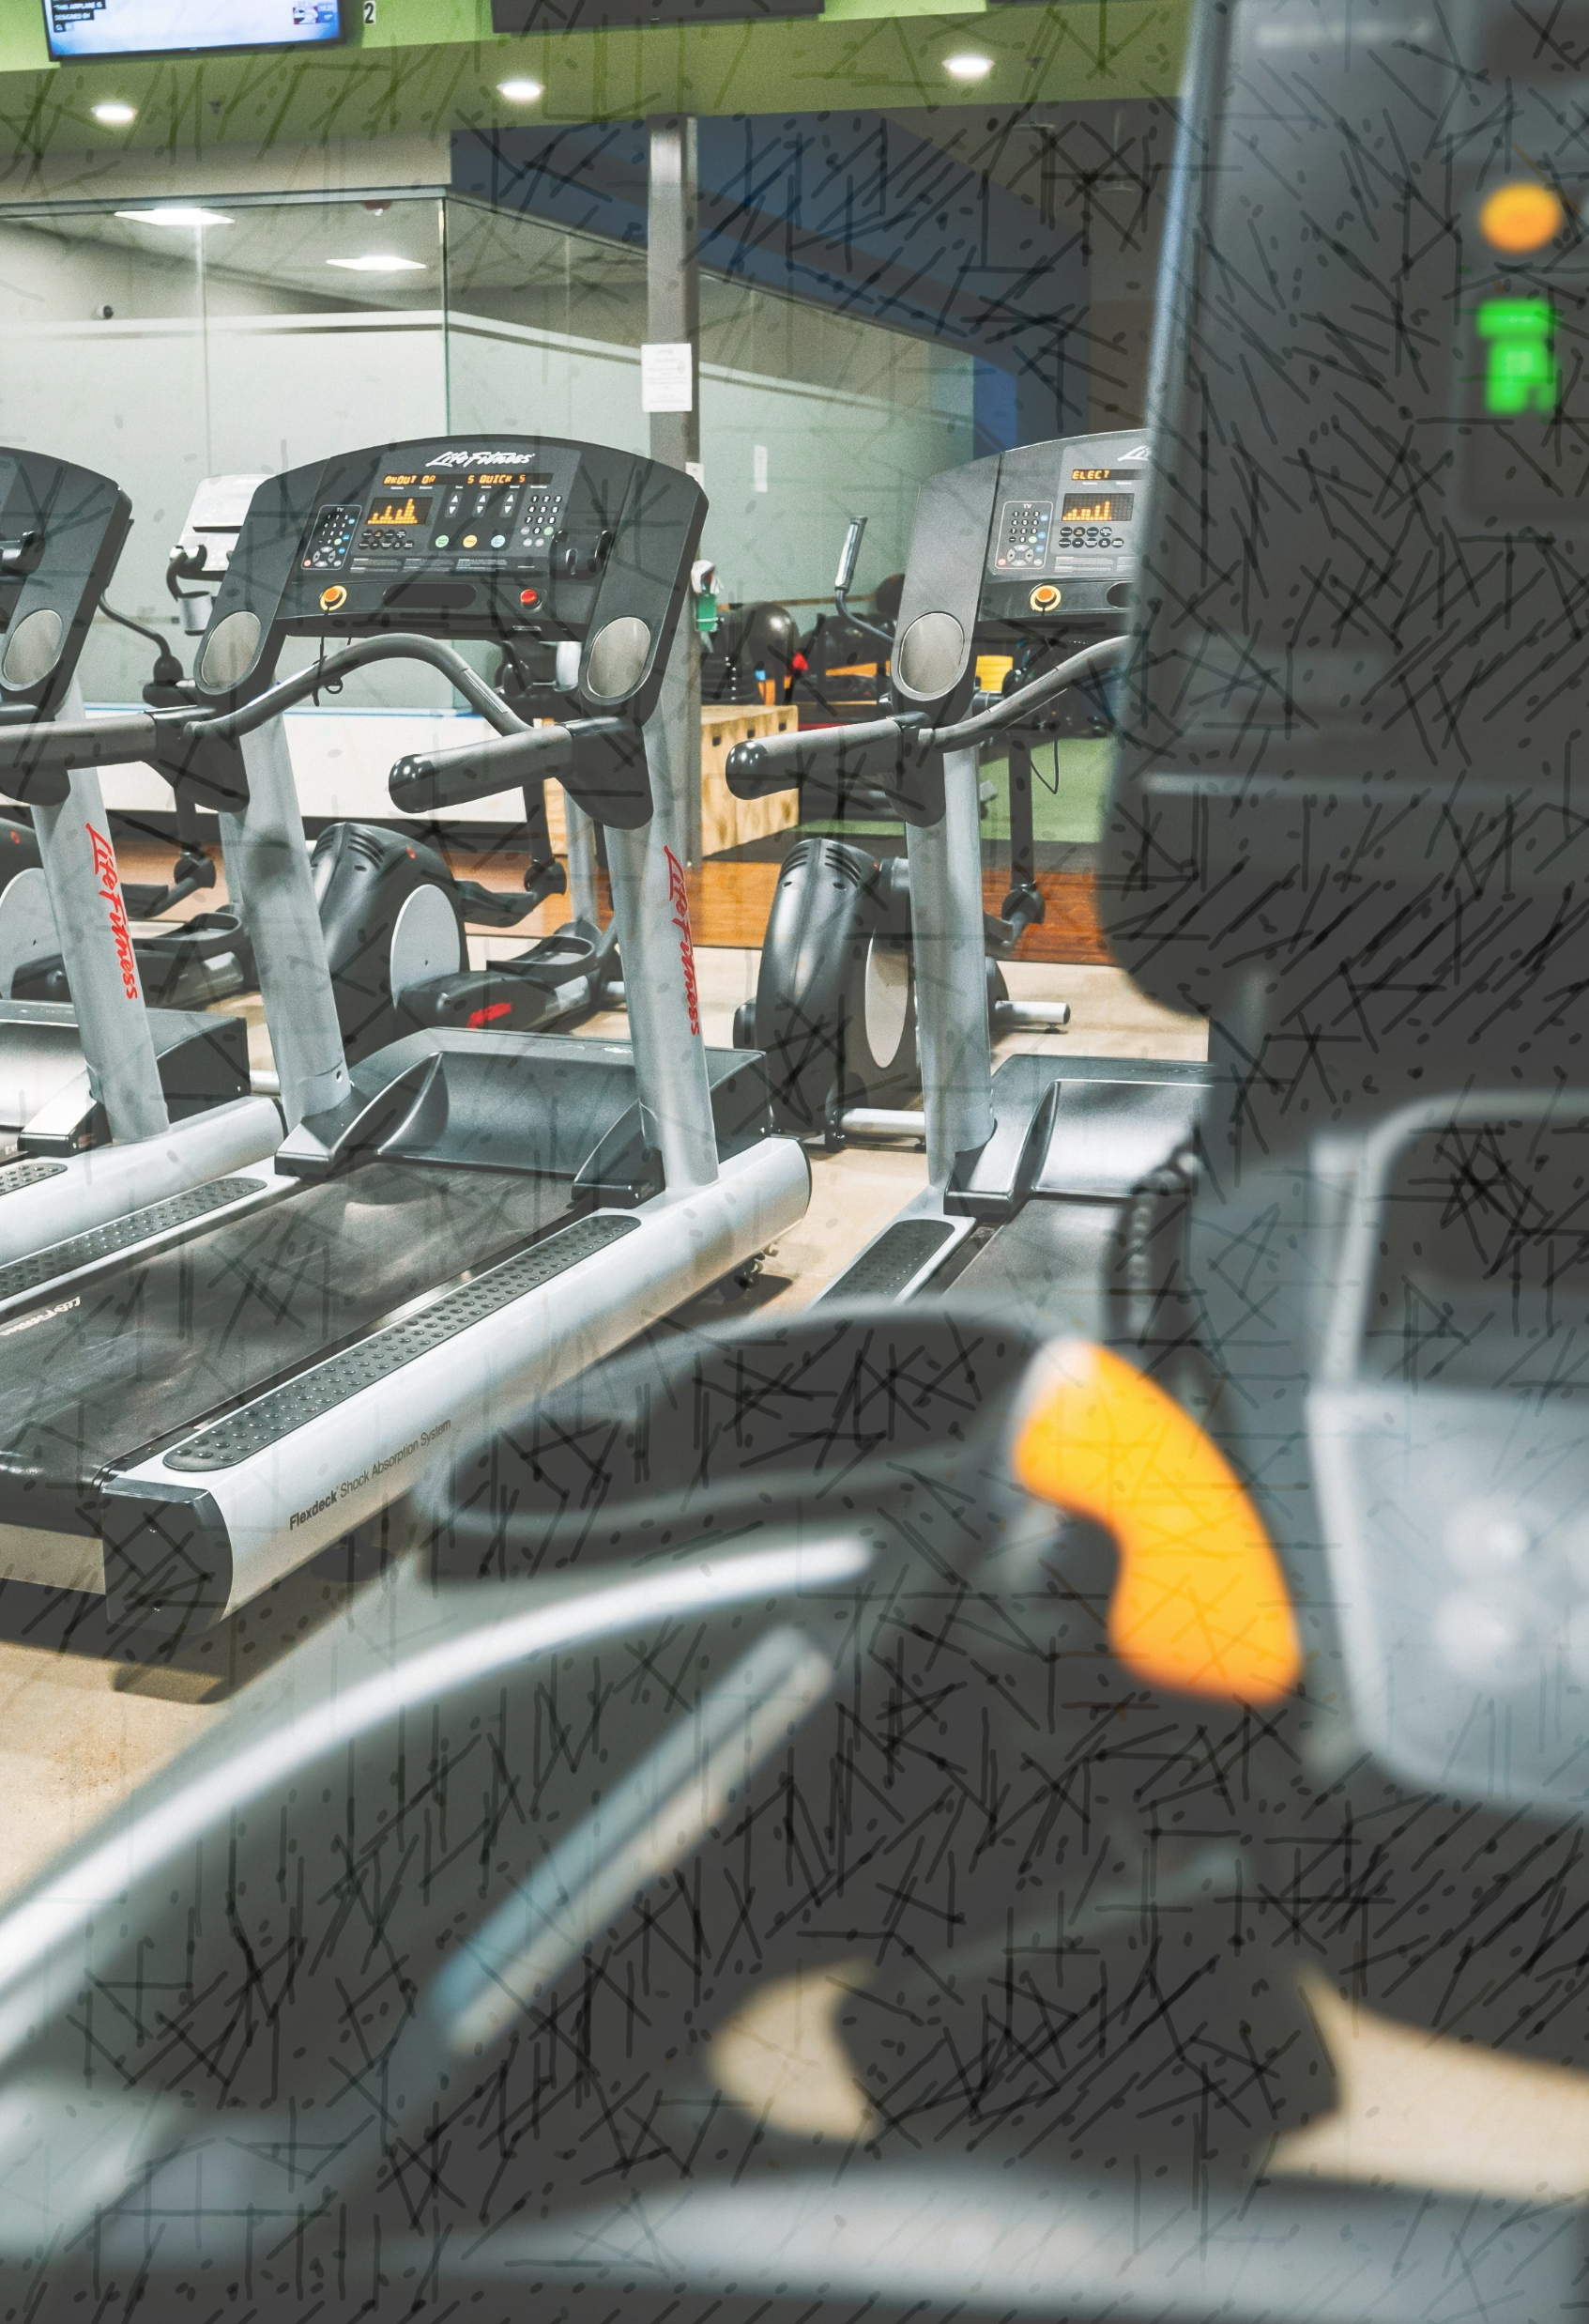
Introduction
Respiratory and heart rate monitoring dataset from aeration study

Slide 4
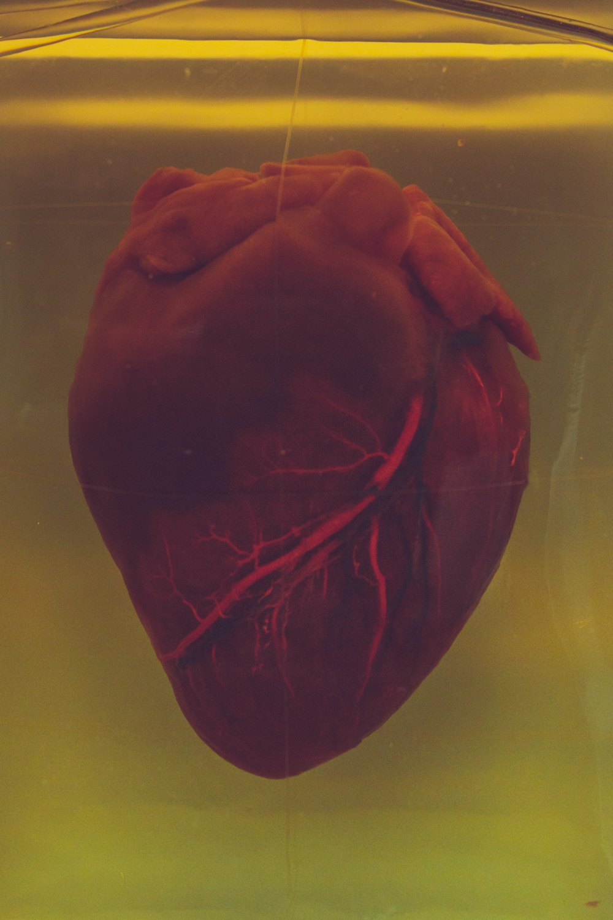
Dataset
Subject[id]_FEM
Subject[id]_PEEP
Subject[Id]_PEEP_BH

Slide 5
Description of data
data.csv:
HR,
VO2
VCO2,
VE
RR
Speed
Time
ID
ID_TEST

Slide 6
Data Preparation
Removing NULLS (imputations)
Type casting
Label Encoding
Analysing Correlation

Slide 7
Additional Features
Added features agreed by medical practitional practitioners to understand the data better
Test_measure.csv:
Heart rate,
oxygen consumption,
carbon dioxide generation,
pulmonary ventilation
Respiratory Rate
Speed
Time
ID
ID_TEST
Test_measure.csv (new -features)
Cardiovascular efficiency (speed / hr)
Respiratory Exchange Ratio (VO2 / VCO2)
HR_Zone(Low, Moderate, High)
VO2 Above Threshold
Speed 5 min average
HR_10 min prior
Normalized Heart Rate

Slide 8

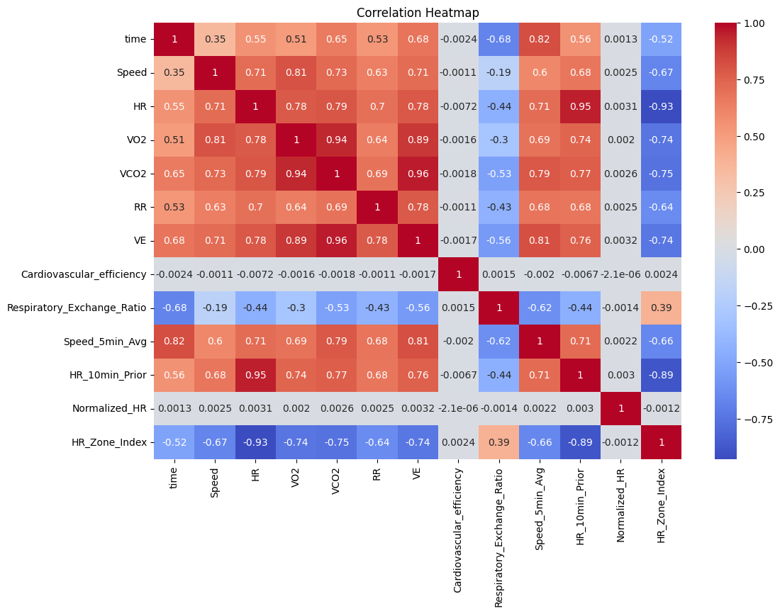
Correlation

Slide 9
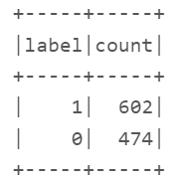
Clustering
Based on the squared euclidean distance,
Using kmeans clustering 2 clusters were found to justify the data better.
- Accuracy score on unseen data 0.7253019551396893.
Number of clusters | Accuracy
2 | 0.72
3 | 0.67
4 | 0.62
5 | 0.58
Re- Sampling

Slide 10
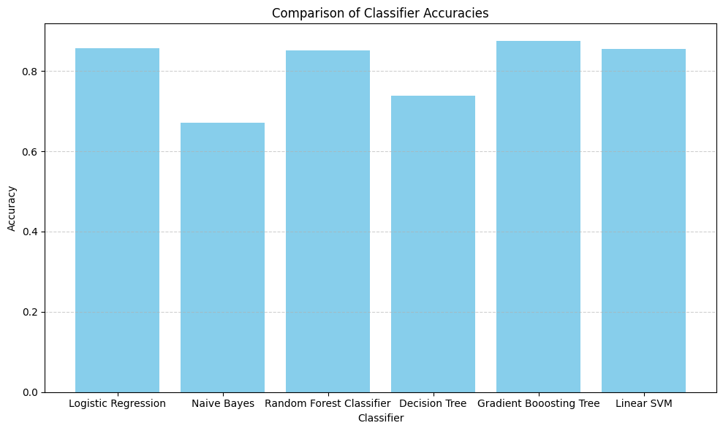
Performance of binary classifiers on this data
Classifier | Accuracy Score
Logistic Regression | 0.85
Naive Bayes | 0.67
Random Forest Classifier | 0.85
Decision Tree | 0.73
Gradient Boosting | 0.87
Linear SVM | 0.85

Slide 11
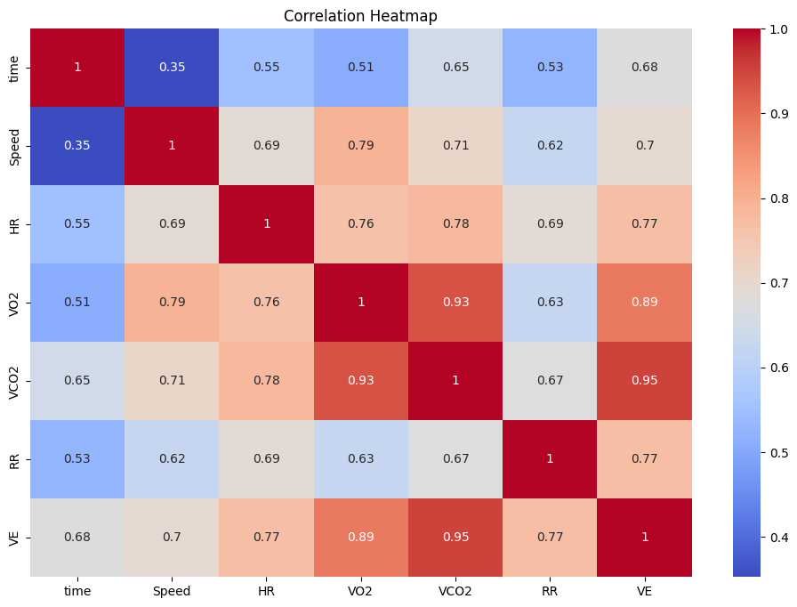
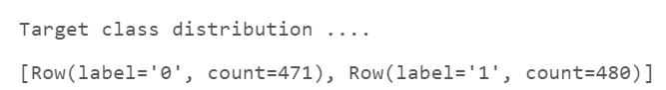
Working on original data, without additional data
Clustering,
Number of clusters = 2
Accuracy Score after evaluating kmeans model on test data = 0.71

Slide 12
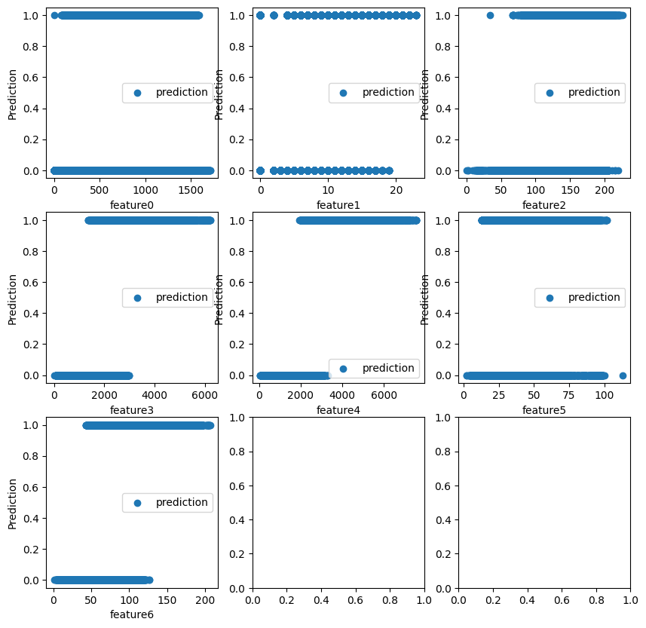
Features vs Clusters
{
0 : 'time’,
1 : 'Speed’,
2 : 'HR’,
3 : 'VO2’,
4 : 'VCO2’,
5 : 'RR’,
6 : 'VE’
}

Slide 13
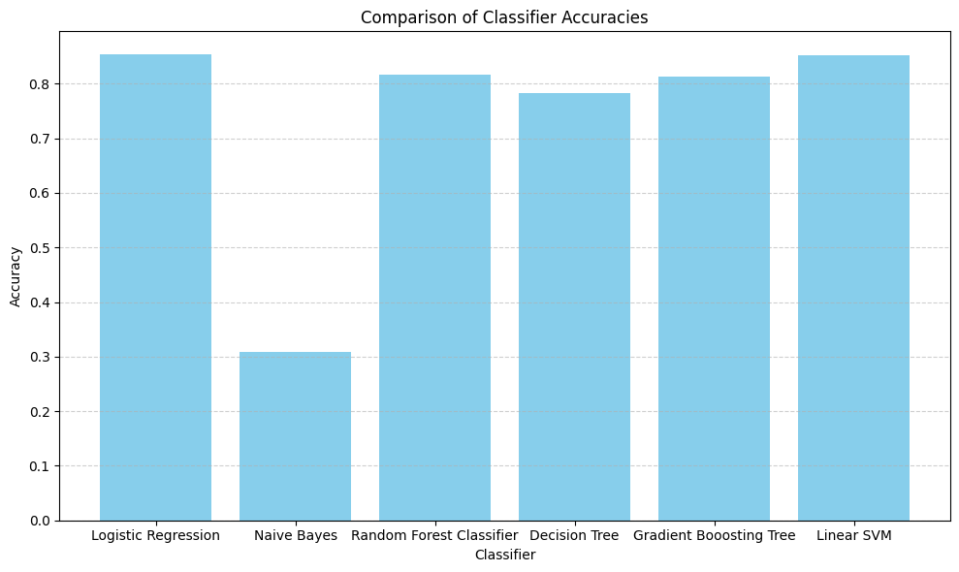
Analysing Performance of Binary Classifiers
Name of Classifier | Accuracy
Logistic Regression | 0.85
Naïve Bayes | 0.30
Random Forest | 0.83
Decision Tree | 0.78
Gradient Boosting | 0.81
Linear SVM | 0.85

Slide 14
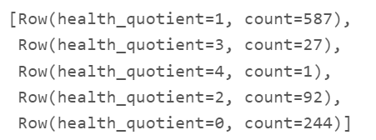
Transforming Data and creating target based on ideal scenarios
Categorizing VO2:
'excellent': 5000,
'very_good': 4000,
'good’: 3000,
'fair': 2000,
'poor': 1000
Categorizing on other metrics:
HR > 100 – (Indicates a scale weaker)
vco2 < 4000 – (Indicates a scale stronger)
VE > 100 – (Indicates a scale stronger)
RR > 60 – (Indicates a scale weaker)

Slide 15
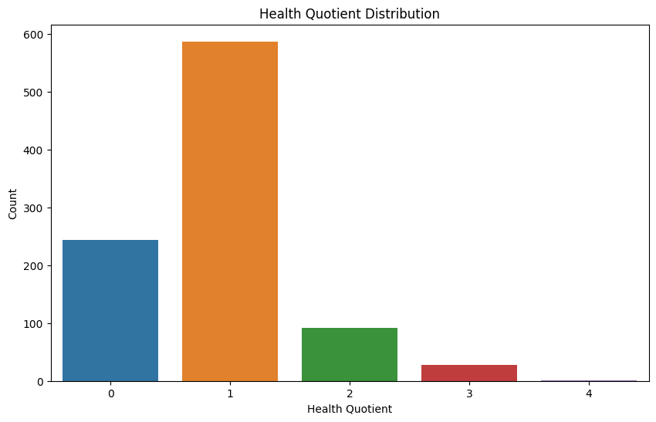
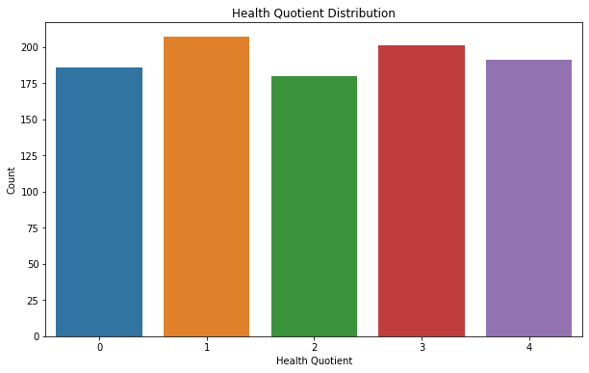
Target Class Distribution Before vs After Resampling

Slide 16
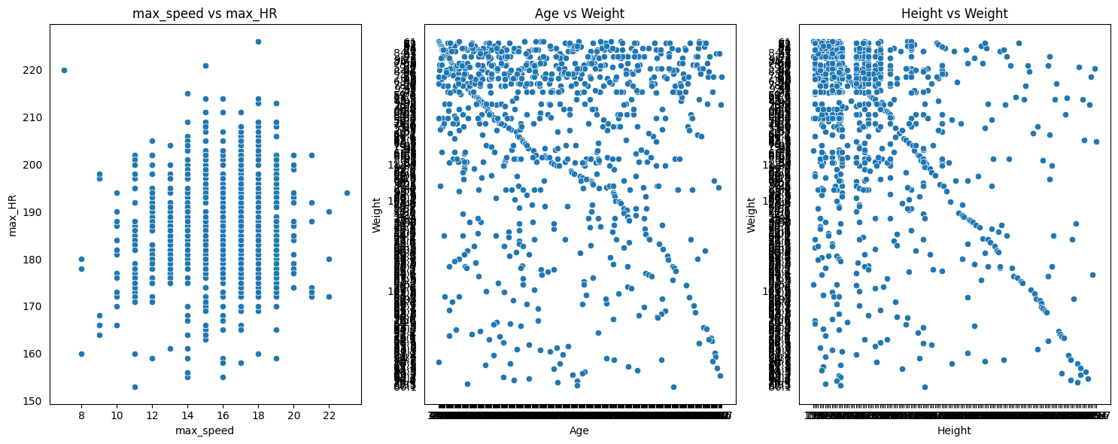
Distribution Of Features Before Resampling

Slide 17
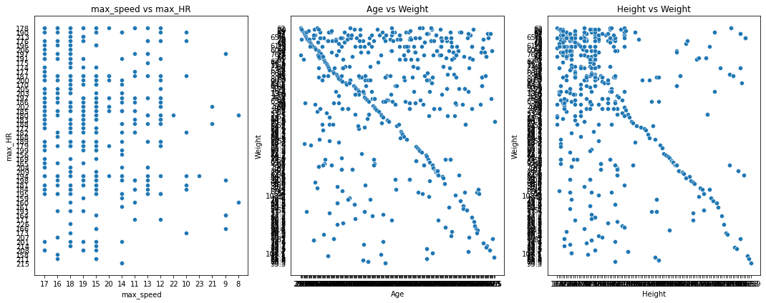
Distribution Of Features After Resampling

Slide 18
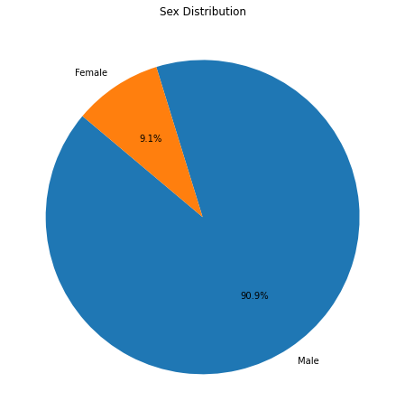
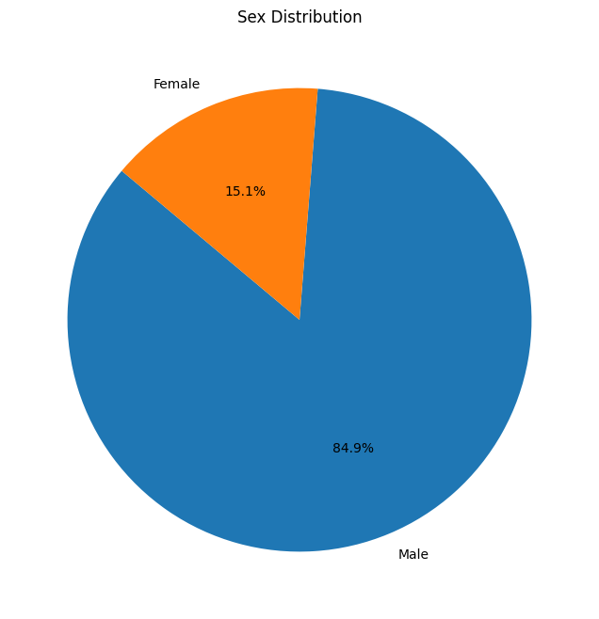
Female vs male Samples Before vs After Resampling

Slide 19
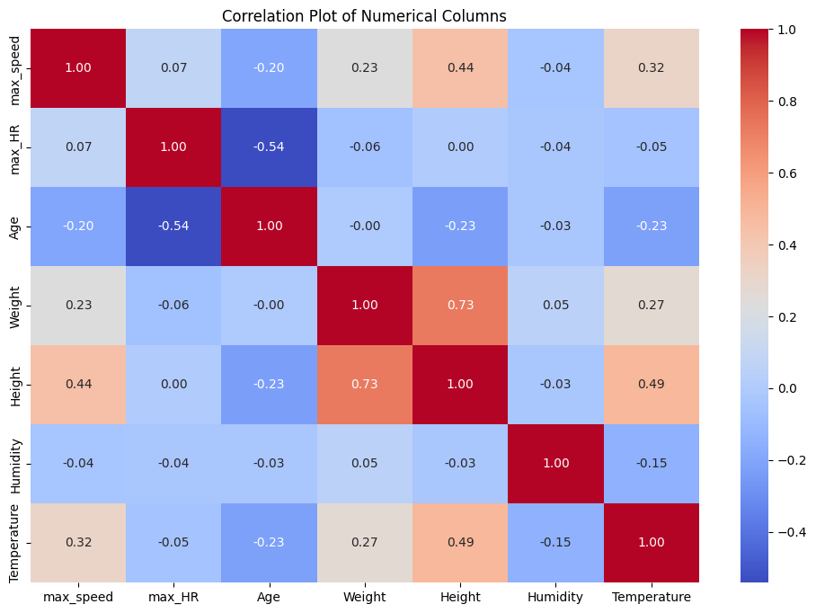
Correlation After Resampling

Slide 20
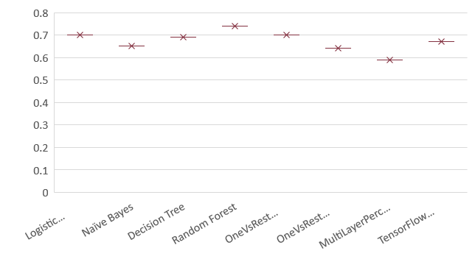
Performance Analysis of Multi- Class Classifiers
Classifier | Accuracy
Logistic Regression | 0.70
Naïve Bayes | 0.65
Decision Tree | 0.69
Random Forest | 0.74
OneVsRest (LR) | 0.70
OneVsRest (LinearSVC) | 0.64
MultiLayerPerceptron | 0.59
TF Sequential NN | 0.67

Slide 21

THANK YOU
Janani Manjangarani Senthil Kumar
jananis1@umbc.edu

